Slide 1

BUTTERWICK PINCHBECK’S ENDOWED CHURCH
OF ENGLAND PRIMARY SCHOOL

Slide 2
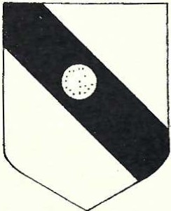
Where does the name Pinchbeck come from?
The school was started by Anthony Pinchbeck who was born in 1615.
The Pinchbeck family had lived in Butterwick since 1211. This is the family crest which is where the school’s badge comes from
Like his father Anthony Pinchbeck was a Yeoman.

Slide 3
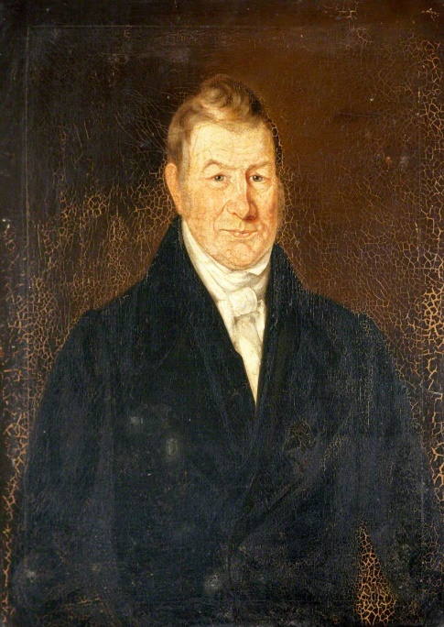
What is a Yeoman?
Yeomen is the name given to those who own their own land and grow crops, today we would call them farmers.
This a portrait of a Yeoman Farmer

Slide 4
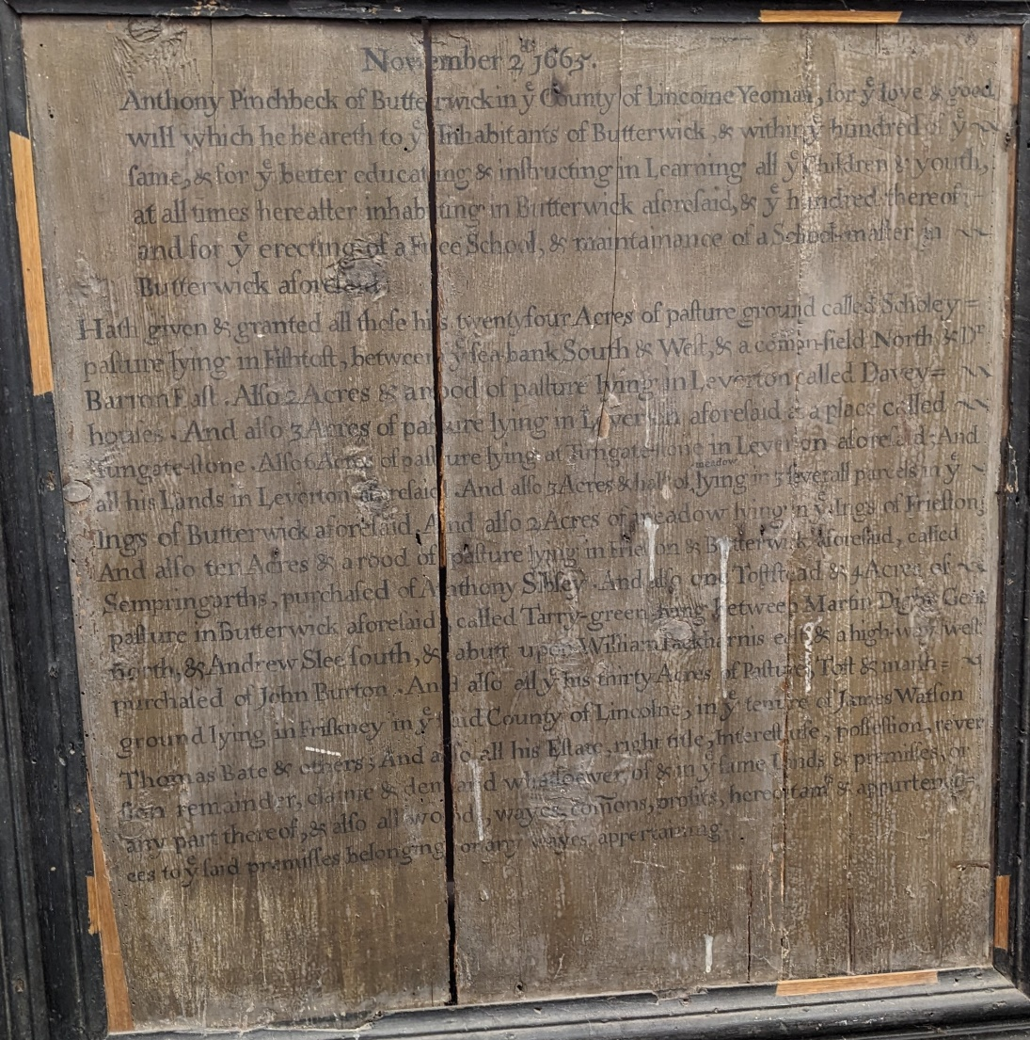
Anthony Pinchbeck made a gift of lands to set up a free school in Butterwick in 1665
Anthony Pinchbecks gift is recorded on a wooden plaque
(The Pinchbeck Trust are planning to have this plaque conserved so that it can be displayed here at the school)

Slide 5
Anthony Pinchbeck’s Gift 1665
The Pinchbeck Trust was created on 2nd November 1665. The wooden plaque tells us that Anthony Pinchbeck made this gift :
  “for the love and goodwill which he beareth to the inhabitants of Butterwick and within the hundred of the same and for the better educating and instructing in learning all the children and youth at all times hereafter”
Butterwick Grammar School opened in 1665. At that time Charles II was the King.

Slide 6
The early years of the school
1670-1767
15th October 1670 Martin Pinchbeck was appointed as the Master of the School (he was Anthony Pinchbeck’s nephew)
At this time only boys went to school
The original school was on School Lane at the back of Pinchbeck House

Slide 7
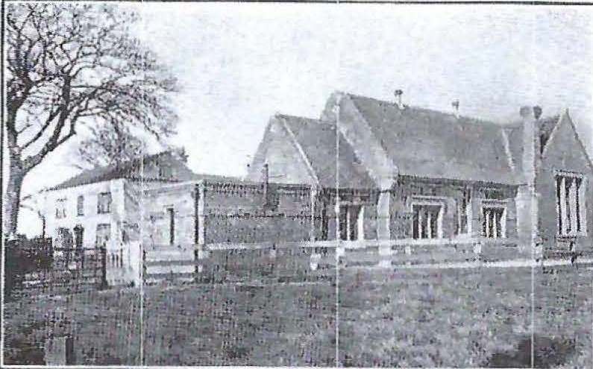
The early years of the school 1835
By 1835 the school building next to Pinchbeck House had been built. There were 73 boys attending the school

Slide 8
7th June 1852
Some of the rules for the management of Butterwick Grammar School
That the hours of attendance, be in the Summer half-year, from 9 to 12 and 2 to 5, and in the Winter half-year from 9 to 12 and 2 to 4.
That no boy be admitted into the School before he can read and spell correctly simple words of at least one syllable.
That the Master be authorized to send home, any boy who presents himself either filthy in his person or ragged and slovenly in his dress.
That the ordinary Vacations be six weeks at Harvest, and three weeks at Christmas.
That every boy using Pens and Ink, be required to pay for the same at the rate of one shilling per annum.

Slide 9
The early years of the school
1859-1876
1859 - The thatched roof of the school was replaced with a slate roof, this date is on one of the gables of the school
1864 - 30 children attended exams
1876 – the school was changed to a Girls’ School and a new Boys’ School and Master’s House were built.

Slide 10
The early years of the school 1878
The Girls’ School had previously been at Freiston National School.
12th July 1878 “all the boys except infants leave Freiston School and join the Butterwick boys on Monday next”
The old school was extended, on one of the walls there is the date 1878 in raised bricks.

Slide 11
The early years of the school 1879
30th May 1879 today closes the School year as well as Freiston National School.
2nd June 1879 School transferred to Butterwick under the name of Pinchbeck’s Endowed Girls’ School, 37 children admitted.
This school then became a school for girls and infants.

Slide 12
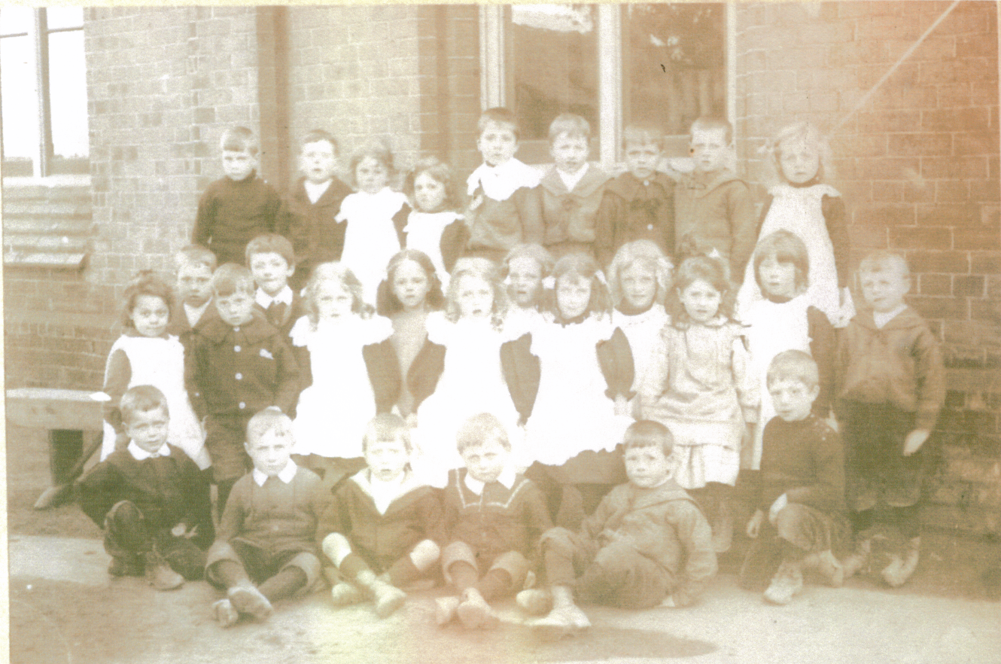
Pupils at Butterwick School for Girls and Infants 1910

Slide 13
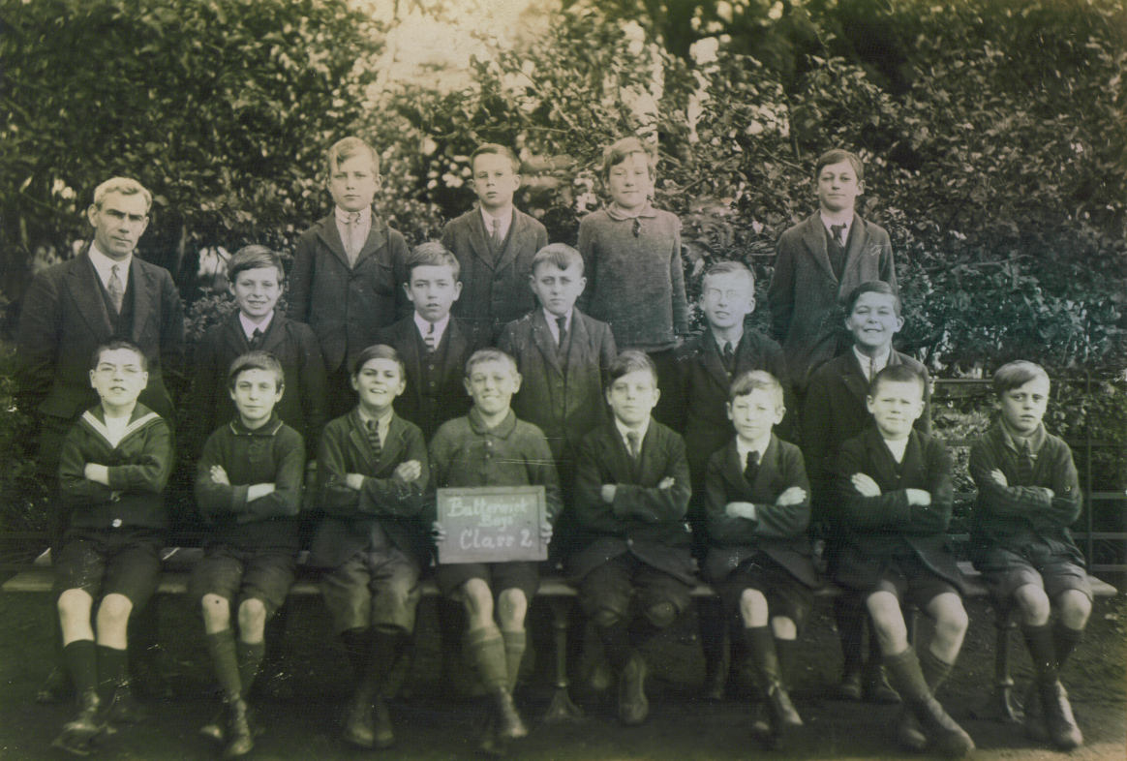
Pupils at Butterwick Boys’
School 1922

Slide 14
The early years of the school 1922
A War Memorial was placed in the Boys’ School, it is a brass mural tablet on oak.
It shows the names of the thirty-four former pupils of the school who died during WW1.

Slide 15
1931
The School Governors agree that the Girls’ School becomes a junior school for boys and girls
and
The Boys’ School becomes a senior school for boys and girls

